Slide 1

Software Design Principles
Ken Ye
https://github.com/rainyheart/bjc-protoss-design_patten-demo.git

Slide 2
What are Software Design Principles?
Software design principles represent a set of guidelines that helps us to avoid having a bad design. The design principles are associated to Robert Martin who gathered them in "Agile Software Development: Principles, Patterns, and Practices". According to Robert Martin there are 3 important characteristics of a bad design that should be avoided:
Rigidity - It is hard to change because every change affects too many other parts of the system.
Fragility - When you make a change, unexpected parts of the system break.
Immobility - It is hard to reuse in another application because it cannot be disentangled from the current application.

Slide 3
Open Close Principle (OCP)
Software entities like classes, modules and functions should be open for extension but closed for modifications.
OPC is a generic principle. You can consider it when writing your classes to make sure that when you need to extend their behavior you don’t have to change the class but to extend it. The same principle can be applied for modules, packages, libraries. If you have a library containing a set of classes there are many reasons for which you’ll prefer to extend it without changing the code that was already written (backward compatibility, regression testing, etc). This is why we have to make sure our modules follow Open Closed Principle.
When referring to the classes Open Close Principle can be ensured by use of Abstract Classes and concrete classes for implementing their behavior. This will enforce having Concrete Classes extending Abstract Classes instead of changing them. Some particular cases of this are Template Pattern and Strategy Pattern.

Slide 4
Dependency Inversion Principle (DIP)
High-level modules should not depend on low-level modules. Both should depend on abstractions.
Abstractions should not depend on details. Details should depend on abstractions.
Dependency Inversion Principle states that we should decouple high level modules from low level modules, introducing an abstraction layer between the high level classes and low level classes. Further more it inverts the dependency: instead of writing our abstractions based on details, the we should write the details based on abstractions.
Dependency Inversion or Inversion of Control are better know terms referring to the way in which the dependencies are realized. In the classical way when a software module(class, framework, etc) need some other module, it initializes and holds a direct reference to it. This will make the 2 modules tight coupled. In order to decouple them the first module will provide a hook(a property, parameter, etc) and an external module controlling the dependencies will inject the reference to the second one.
By applying the Dependency Inversion the modules can be easily changed by other modules just changing the dependency module. Factories and Abstract Factories can be used as dependency frameworks, but there are specialized frameworks for that, known as Inversion of Control Container.

Slide 5
Interface Segregation Principle (ISP)
Clients should not be forced to depend upon interfaces that they don't use.
This principle teaches us to take care how we write our interfaces. When we write our interfaces we should take care to add only methods that should be there. If we add methods that should not be there the classes implementing the interface will have to implement those methods as well. For example if we create an interface called Worker and add a method lunch break, all the workers will have to implement it. What if the worker is a robot?
As a conclusion Interfaces containing methods that are not specific to it are called polluted or fat interfaces. We should avoid them.

Slide 6
Single Responsibility Principle (SRP)
A class should have only one reason to change.
In this context a responsibility is considered to be one reason to change. This principle states that if we have 2 reasons to change for a class, we have to split the functionality in two classes. Each class will handle only one responsibility and on future if we need to make one change we are going to make it in the class which handle it. When we need to make a change in a class having more responsibilities the change might affect the other functionality of the classes.
Single Responsibility Principle was introduced Tom DeMarco in his book Structured Analysis and Systems Specification, 1979. Robert Martin reinterpreted the concept and defined the responsibility as a reason to change.

Slide 7
Liskov's Substitution Principle (LSV)
Derived types must be completely substitutable for their base types.
This principle is just an extension of the Open Close Principle in terms of behavior meaning that we must make sure that new derived classes are extending the base classes without changing their behavior. The new derived classes should be able to replace the base classes without any change in the code.
Liskov's Substitution Principle was introduced by Barbara Liskov in a 1987 Conference on Object Oriented Programming Systems Languages and Applications, in Data abstraction and hierarchy

Slide 8
Software Design Patterns

Slide 9
Patterns by Type
Creational
Creational patterns are ones that create objects for you, rather than having you instantiate objects directly. This gives your program more flexibility in deciding which objects need to be created for a given case
Structural
These concern class and object composition. They use inheritance to compose interfaces and define ways to compose objects to obtain new functionality.
Behavioral
Most of these design patterns are specifically concerned with communication between objects.

Slide 10
Creational
Abstract factory pattern groups object factories that have a common theme.
Builder pattern constructs complex objects by separating construction and representation.
Factory method pattern creates objects without specifying the exact class to create.
Prototype pattern creates objects by cloning an existing object.
Singleton pattern restricts object creation for a class to only one instance

Slide 11
Structural
Adapter allows classes with incompatible interfaces to work together by wrapping its own interface around that of an already existing class.
Bridge decouples an abstraction from its implementation so that the two can vary independently.
Composite composes zero-or-more similar objects so that they can be manipulated as one object.
Decorator dynamically adds/overrides behaviour in an existing method of an object.

Slide 12
Structural
Facade provides a simplified interface to a large body of code.
Flyweight reduces the cost of creating and manipulating a large number of similar objects.
Proxy provides a placeholder for another object to control access, reduce cost, and reduce complexity.

Slide 13
Behavioral
Chain of responsibility delegates commands to a chain of processing objects.
Command creates objects which encapsulate actions and parameters.
Interpreter implements a specialized language.
Iterator accesses the elements of an object sequentially without exposing its underlying representation.
Mediator allows loose coupling between classes by being the only class that has detailed knowledge of their methods.
Memento provides the ability to restore an object to its previous state (undo).

Slide 14
Behavioral
Observer is a publish/subscribe pattern which allows a number of observer objects to see an event.
State allows an object to alter its behavior when its internal state changes.
Strategy allows one of a family of algorithms to be selected on-the-fly at runtime.
Template method defines the skeleton of an algorithm as an abstract class, allowing its subclasses to provide concrete behavior.
Visitor separates an algorithm from an object structure by moving the hierarchy of methods into one object.

Slide 15
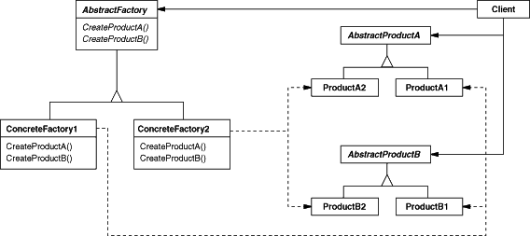
Abstract Factory
Abstract Factory pattern provides an interface for creating families of related or dependent objects without specifying their concrete classes.

Slide 16
Abstract Factory
The Abstract Factory design pattern solves problems like:
How can an application be independent of how its objects are created?
How can a class be independent of how the objects it requires are created?
How can families of related or dependent objects be created?
The Abstract Factory design pattern describes how to solve such problems:
Encapsulate object creation in a separate (factory) object. That is, define an interface (AbstractFactory) for creating objects, and implement the interface.
A class delegates object creation to a factory object instead of creating objects directly.

Slide 17
Abstract Factory
Can you think out a scenario to use abstract factory pattern in your previous coding task?

Slide 18
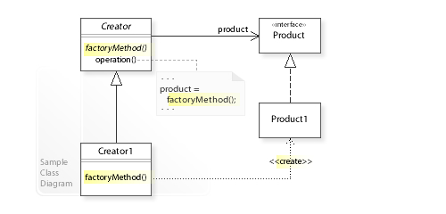
Factory Method
Define an interface for creating an object, but let subclasses decide which class to instantiate. The Factory method lets a class defer instantiation it uses to subclasses

Slide 19
Factory Method
The Factory Method design pattern solves problems like:
How can an object be created so that subclasses can redefine which class to instantiate?
How can a class defer instantiation to subclasses?
The Factory Method design pattern describes how to solve such problems:
Define a separate operation (factory method) for creating an object.
Create an object by calling a factory method.

Slide 20
Factory Method
Can you think out a scenario to use factory method pattern in your previous coding task?

Slide 21
Singleton
The key idea in this pattern is to make the class itself responsible for controlling its instantiation (that it is instantiated only once).
The hidden constructor (declared private) ensures that the class can never be instantiated from outside the class.
The public static operation can be accessed easily by using the class name and operation name (Singleton.getInstance()).

Slide 22
Singleton
The singleton design pattern solves problems like:
How can it be ensured that a class has only one instance?
How can the sole instance of a class be accessed easily?
How can a class control its instantiation?
How can the number of instances of a class be restricted?
The singleton design pattern describes how to solve such problems:
Hide the constructor of the class.
Define a public static operation (getInstance()) that returns the sole instance of the class.

Slide 23
Singleton
Can you think out a scenario to use singleton pattern in your previous coding task?

Slide 24
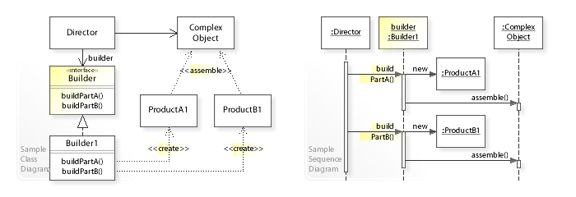
Builder
The intent of the Builder design pattern is to separate the construction of a complex object from its representation. By doing so the same construction process can create different representations

Slide 25
Builder
The Builder design pattern solves problems like:
How can a class (the same construction process) create different representations of a complex object?
How can a class that includes creating a complex object be simplified?
The Builder design pattern describes how to solve such problems:
Encapsulate creating and assembling the parts of a complex object in a separate Builder object.
A class delegates object creation to a Builder object instead of creating the objects directly.

Slide 26
Builder
Can you think out a scenario to use builder pattern in your previous coding task?

Slide 27
Prototype
The prototype pattern is a creational design pattern in software development. It is used when the type of objects to create is determined by a prototypical instance, which is cloned to produce new objects. This pattern is used to:
avoid subclasses of an object creator in the client application, like the factory method pattern does.
avoid the inherent cost of creating a new object in the standard way (e.g., using the 'new' keyword) when it is prohibitively expensive for a given application.

Slide 28
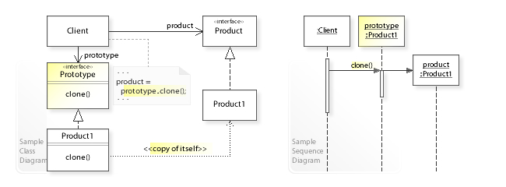
Prototype

Slide 29
Prototype
The Prototype design pattern solves problems like:
How can objects be created so that which objects to create can be specified at run-time?
How can dynamically loaded classes be instantiated?
The Prototype design pattern describes how to solve such problems:
Define a Prototype object that returns a copy of itself.
Create new objects by copying a Prototype object.

Slide 30
Prototype
Can you think out a scenario to use prototype pattern in your previous coding task?

Slide 31
Adaptor
Adapter pattern converts the interface of a class into another interface clients expect. Adapter lets classes work together that couldn't otherwise because of incompatible interfaces.
The pre-condiction is that do not change the existing interface/class, but leverage (inherit/composite) an existing object to implement a new interface.

Slide 32
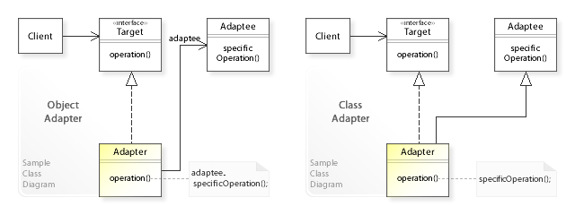
Adaptor

Slide 33
Adaptor
The Adapter design pattern solves problems like:
How can a class be reused that does not have an interface that a client requires?
How can classes that have incompatible interfaces work together?
How can an alternative interface be provided for a class?
The Adapter design pattern describes how to solve such problems:
Define a separate Adapter class that converts the (incompatible) interface of a class (Adaptee) into another interface (Target) clients require.
Work through an Adapter to work with (reuse) classes that do not have the required interface.

Slide 34
Adapter
Can you think out a scenario to use adapter pattern in your previous coding task?

Slide 35
Bridge
The bridge pattern is a design pattern used in software engineering that is meant to "decouple an abstraction from its implementation so that the two can vary independently", introduced by the Gang of Four. The bridge uses encapsulation, aggregation, and can use inheritance to separate responsibilities into different classes.

Slide 36
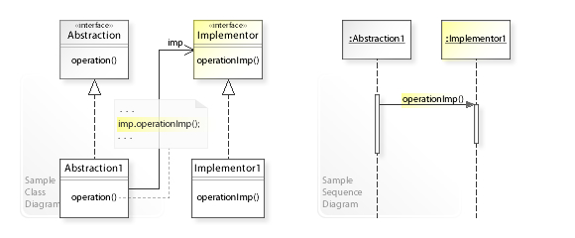
Bridge

Slide 37
Bridge
What problems can the Bridge design pattern solve?
An abstraction and its implementation should be defined and extended independently from each other.
A compile-time binding between an abstraction and its implementation should be avoided so that an implementation can be selected at run-time.
What solution does the Bridge design pattern describe?
Separate an abstraction (Abstraction) from its implementation (Implementor) by putting them in separate class hierarchies.
Implement the Abstraction in terms of (by delegating to) an Implementor object.

Slide 38
Bridge
Can you think out a scenario to use bridge pattern in your previous coding task?

Slide 39
Composite
The composite pattern describes a group of objects that is treated the same way as a single instance of the same type of object. The intent of a composite is to "compose" objects into tree structures to represent part-whole hierarchies. Implementing the composite pattern lets clients treat individual objects and compositions uniformly

Slide 40
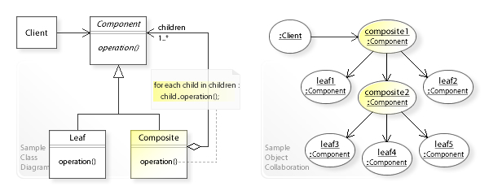
Composite

Slide 41
Composite
What problems can the Composite design pattern solve?
A part-whole hierarchy should be represented so that clients can treat part and whole objects uniformly.
A part-whole hierarchy should be represented as tree structure.
What solution does the Composite design pattern describe?
Define a unified Component interface for both part (Leaf) objects and whole (Composite) objects.
Individual Leaf objects implement the Component interface directly, and Composite objects forward requests to their child components.

Slide 42
Composite
Can you think out a scenario to use composite pattern in your previous coding task?

Slide 43
Decorator
Decorator pattern allows behavior to be added to an individual object, either statically or dynamically, without affecting the behavior of other objects from the same class.
The decorator pattern is often useful for adhering to the Single Responsibility Principle, as it allows functionality to be divided between classes with unique areas of concern.
The decorator pattern is structurally nearly identical to the chain of responsibility pattern, the difference being that in a chain of responsibility, exactly one of the classes handles the request, while for the decorator, all classes handle the request.

Slide 44
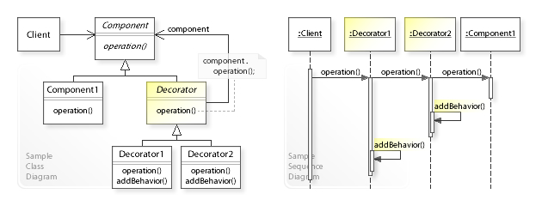
Decorator

Slide 45
Decorator
What problems can the Decorator design pattern solve?
Responsibilities should be added to (and removed from) an object dynamically at run-time.
A flexible alternative to subclassing for extending functionality should be provided.
What solution does the Decorator design pattern describe?
Define Decorator objects that
implement the interface of the extended (decorated) object (Component) transparently by forwarding all requests to it and
perform additional functionality before/after forwarding a request.

Slide 46
Decorator
Can you think out a scenario to use decorator pattern in your previous coding task?

Slide 47
Facade
Provide a unified interface to a set of interfaces in a subsystem. Facade defines a higher-level interface that makes the subsystem easier to use.
The pre-condiction is that not changing the existing several intefaces, but build a new one and consolidate/simplify the interface to caller.

Slide 48
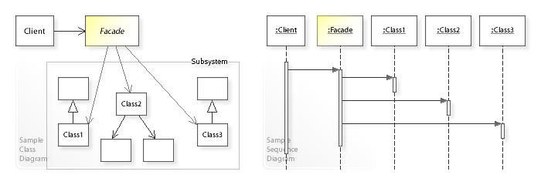
Facade

Slide 49
Facade
Can you think out a scenario to use facade pattern in your previous coding task?

Slide 50
Flyweight
A flyweight is an object that minimizes memory usage by sharing as much data as possible with other similar objects; it is a way to use objects in large numbers when a simple repeated representation would use an unacceptable amount of memory. Often some parts of the object state can be shared, and it is common practice to hold them in external data structures and pass them to the objects temporarily when they are used.

Slide 51
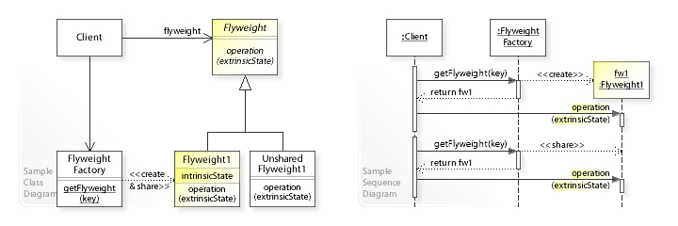
Flyweight

Slide 52
Flyweight
What problems can the Flyweight design pattern solve?
Large numbers of objects should be supported efficiently.
Creating large numbers of objects should be avoided.
What solution does the Flyweight design pattern describe?
Define Flyweight objects that
store intrinsic (invariant) state that can be shared and
provide an interface through which extrinsic (variant) state can be passed in.

Slide 53
Flyweight
Can you think out a scenario to use flyweight pattern in your previous coding task?

Slide 54
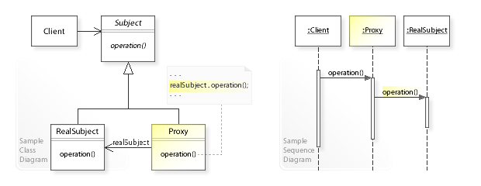
Proxy
Proxy pattern provides a surrogate or placeholder for another object to control access to it.

Slide 55
Proxy
What problems can the Proxy design pattern solve?
The access to an object should be controlled.
Additional functionality should be provided when accessing an object.
What solution does the Proxy design pattern describe?
Define a separate Proxy object that
can be used as substitute for another object (Subject) and
implements additional functionality to control the access to this subject.

Slide 56
Proxy
Can you think out a scenario to use proxy pattern in your previous coding task?

Slide 57
Chain-of-responsibility
Chain-of-responsibility pattern is a design pattern consisting of a source of command objects and a series of processing objects.
Each processing object contains logic that defines the types of command objects that it can handle; the rest are passed to the next processing object in the chain.

Slide 58
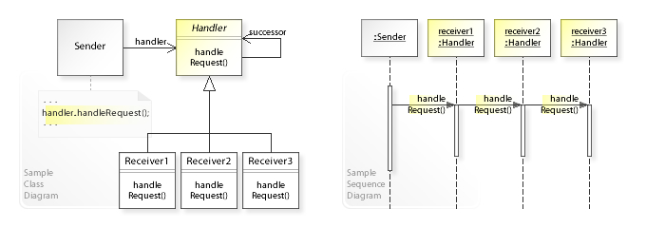
Chain-of-responsibility

Slide 59
Chain-of-responsibility
What problems can the Chain of Responsibility design pattern solve?
Coupling the sender of a request to its receiver should be avoided.
It should be possible that more than one receiver can handle a request.
What solution does the Chain of Responsibility design pattern describe?
Define a chain of receiver objects having the responsibility, depending on run-time conditions, to either handle a request or forward it to the next receiver on the chain (if any).

Slide 60
Chain-of-responsibility
Can you think out a scenario to use Chain-of-responsibility pattern in your previous coding task?

Slide 61
Command
Command pattern is a behavioral design pattern in which an object is used to encapsulate all information needed to perform an action or trigger an event at a later time. This information includes the method name, the object that owns the method and values for the method parameters.

Slide 62
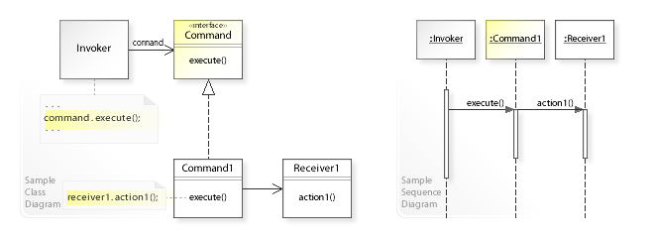
Command

Slide 63
Command
What problems can the Command design pattern solve?
Coupling the invoker of a request to a particular request should be avoided. That is, hard-wired requests should be avoided.
It should be possible to configure an object (that invokes a request) with a request.
What solution does the Command design pattern describe?
Define separate (command) objects that encapsulate a request.
A class delegates a request to a command object instead of implementing a particular request directly.

Slide 64
Command
Can you think out a scenario to use command pattern in your previous coding task?

Slide 65
Interpreter
Interpreter pattern is a design pattern that specifies how to evaluate sentences in a language. The basic idea is to have a class for each symbol (terminal or nonterminal) in a specialized computer language. The syntax tree of a sentence in the language is an instance of the composite pattern and is used to evaluate (interpret) the sentence for a client.

Slide 66
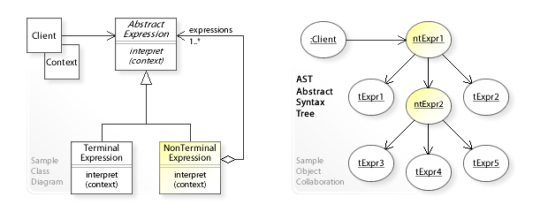
Interpreter

Slide 67
Interpreter
What problems can the Interpreter design pattern solve?
A grammar for a simple language should be defined
so that sentences in the language can be interpreted.
What solution does the Interpreter design pattern describe?
Define a grammar for a simple language by defining an Expression class hierarchy and implementing an interpret() operation.
Represent a sentence in the language by an abstract syntax tree (AST) made up of Expression instances.
Interpret a sentence by calling interpret() on the AST.

Slide 68
Interpreter
Can you think out a scenario to use interpreter pattern in your previous coding task?

Slide 69
Iterator
Iterator pattern is a design pattern in which an iterator is used to traverse a container and access the container's elements. The iterator pattern decouples algorithms from containers; in some cases, algorithms are necessarily container-specific and thus cannot be decoupled.

Slide 70
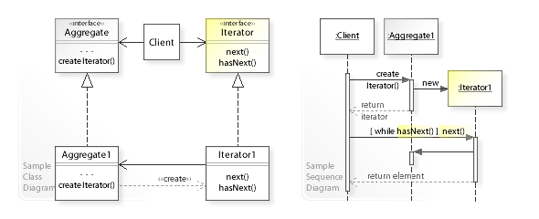
Iterator

Slide 71
Iterator
What problems can the Iterator design pattern solve?
The elements of an aggregate object should be accessed and traversed without exposing its representation (data structures).
New traversal operations should be defined for an aggregate object without changing its interface.
What solution does the Iterator design pattern describe?
Define a separate (iterator) object that encapsulates accessing and traversing an aggregate object.
Clients use an iterator to access and traverse an aggregate without knowing its representation (data structures).

Slide 72
Iterator
Can you think out a scenario to use iterator pattern in your previous coding task?

Slide 73
Mediator
Mediator pattern defines an object that encapsulates how a set of objects interact. This pattern is considered to be a behavioral pattern due to the way it can alter the program's running behavior.

Slide 74
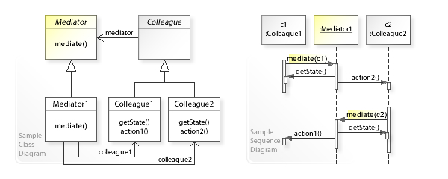
Mediator

Slide 75
Mediator
What problems can the Mediator design pattern solve?
Tight coupling between a set of interacting objects should be avoided.
It should be possible to change the interaction between a set of objects independently.
What solution does the Mediator design pattern describe?
Define a separate (mediator) object that encapsulates the interaction between a set of objects.
Objects delegate their interaction to a mediator object instead of interacting with each other directly.

Slide 76
Mediator
Can you think out a scenario to use mediator pattern in your previous coding task?

Slide 77
Memento
The memento pattern is a software design pattern that provides the ability to restore an object to its previous state (undo via rollback).

Slide 78
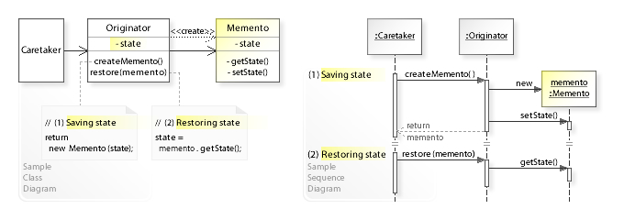
Memento

Slide 79
Memento
What problems can the Memento design pattern solve?
The internal state of an object should be saved externally so that the object can be restored to this state later.
The object's encapsulation must not be violated.
What solution does the Memento design pattern describe?
Make an object (originator) itself responsible for
saving its internal state to a (memento) object and
restoring to a previous state from a (memento) object.

Slide 80
Memento
Can you think out a scenario to use memento pattern in your previous coding task?

Slide 81
Observer
The observer pattern is a software design pattern in which an object, called the subject, maintains a list of its dependents, called observers, and notifies them automatically of any state changes, usually by calling one of their methods.

Slide 82
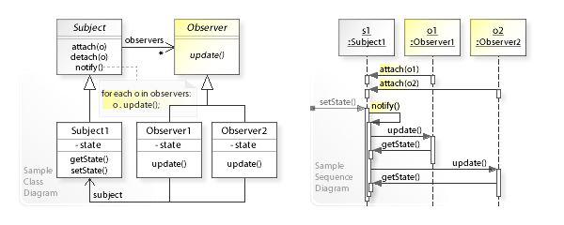
Observer

Slide 83
Observer
The Observer pattern addresses the following problems:
A one-to-many dependency between objects should be defined without making the objects tightly coupled.
It should be ensured that when one object changes state an open-ended number of dependent objects are updated automatically.
It should be possible that one object can notify an open-ended number of other objects.
What solution does the Observer design pattern describe?
Define Subject and Observer objects
so that when a subject changes state, all registered observers are notified and updated automatically.

Slide 84
Observer
Can you think out a scenario to use observer pattern in your previous coding task?

Slide 85
State
The state pattern is a behavioral software design pattern that implements a state machine in an object-oriented way. With the state pattern, a state machine is implemented by implementing each individual state as a derived class of the state pattern interface, and implementing state transitions by invoking methods defined by the pattern's superclass.
This pattern is used in computer programming to encapsulate varying behavior for the same object based on its internal state. This can be a cleaner way for an object to change its behavior at runtime without resorting to large monolithic conditional statements and thus improve maintainability.

Slide 86
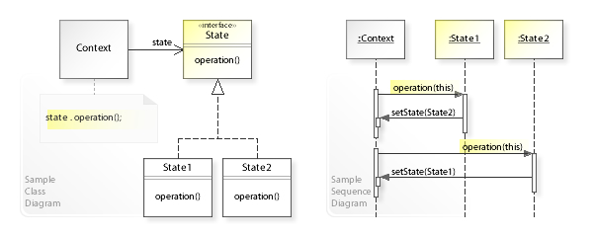
State

Slide 87
State
What problems can the State design pattern solve?
An object should change its behavior when its internal state changes.
State-specific behavior should be defined independently. That is, new states should be added and the behavior of existing states should be changed independently.
What solution does the State design pattern describe?
Define separate (state) objects that encapsulate state-specific behavior for each state. That is, define an interface (State) for performing state-specific behavior, and define classes that implement the interface for each state.
A class delegates state-specific behavior to its current state object instead of implementing state-specific behavior directly.

Slide 88
State
Can you think out a scenario to use state pattern in your previous coding task?

Slide 89
Strategy
In computer programming, the strategy pattern (also known as the policy pattern) is a behavioral software design pattern that enables selecting an algorithm at runtime. The strategy pattern
defines a family of algorithms,
encapsulates each algorithm, and
makes the algorithms interchangeable within that family.

Slide 90
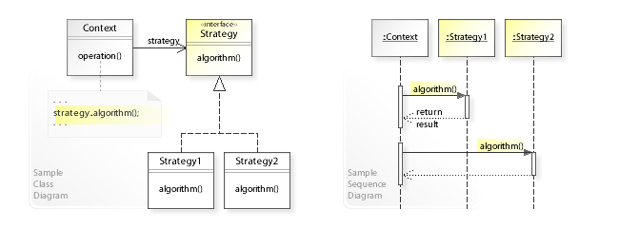
Strategy

Slide 91
Strategy
What problems can the Strategy design pattern solve?
A class should be configured with an algorithm instead of implementing an algorithm directly.
An algorithm should be selected and exchanged at run-time.
What solution does the Strategy design pattern describe?
Define a separate (strategy) object that encapsulates an algorithm. That is, define an interface (Strategy) for performing an algorithm, and define classes that implement the interface (algorithm) in different ways.
A class delegates an algorithm to a strategy object at run-time instead of implementing an algorithm directly (that is, instead of committing to an algorithm at compile-time).

Slide 92
Strategy
Can you think out a scenario to use strategy pattern in your previous coding task?

Slide 93
Template Method
Template method pattern is a behavioral design pattern that defines the program skeleton of an algorithm in an operation, deferring some steps to subclasses. It lets one redefine certain steps of an algorithm without changing the algorithm's structure.

Slide 94
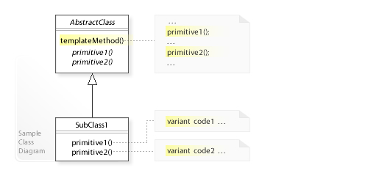
Template Method

Slide 95
Template Method
What problems can the Template Method design pattern solve?
The invariant parts of a behavior should be implemented only once so that subclasses can implement the variant parts.
Subclasses should redefine only certain parts of a behavior without changing the other parts.
What solution does the Template Method design pattern describe?
Define abstract operations (primitives) for the variant parts of a behavior.
Define a template method that
implements the invariant parts of a behavior and
calls abstract operations (primitives) that subclasses implement.

Slide 96
Template Method
Can you think out a scenario to use template method pattern in your previous coding task?

Slide 97
Visitor
Visitor design pattern is a way of separating an algorithm from an object structure on which it operates. A practical result of this separation is the ability to add new operations to existent object structures without modifying the structures. It is one way to follow the open/closed principle.

Slide 98
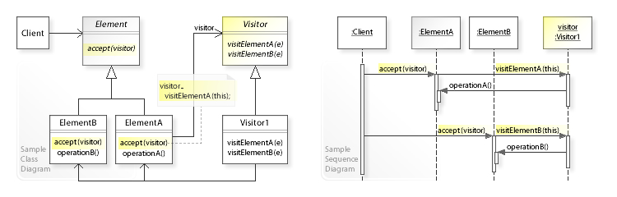
Visitor

Slide 99
Visitor
What problems can the Visitor design pattern solve?
It should be possible to define a new operation for (some) classes of an object structure without changing the classes.
What solution does the Visitor design pattern describe?
Define a separate (visitor) object that implements an operation to be performed on elements of an object structure.
Clients traverse the object structure and call a dispatching operation accept(visitor) on an element — that "dispatches" (delegates) the request to the "accepted visitor object". The visitor object then performs the operation on the element ("visits the element").

Slide 100
Visitor
Can you think out a scenario to use visitor pattern in your previous coding task?

Slide 101
When should you use design pattern?
Requirement
Requirement
Requirement
Do not use design pattern for design pattern!

Slide 102
Relax
https://www.bilibili.com/video/av14539601/

Slide 103
五剑境界
利剑无意
软剑无常
重剑无锋
木剑无俦
无剑无招
手中无剑，心中有剑！

Slide 104
Thank you !
Lecturer: Ken Ye
Wechat: kenjzyip
Mobile: 13570548910

